Slide 1



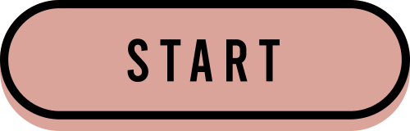


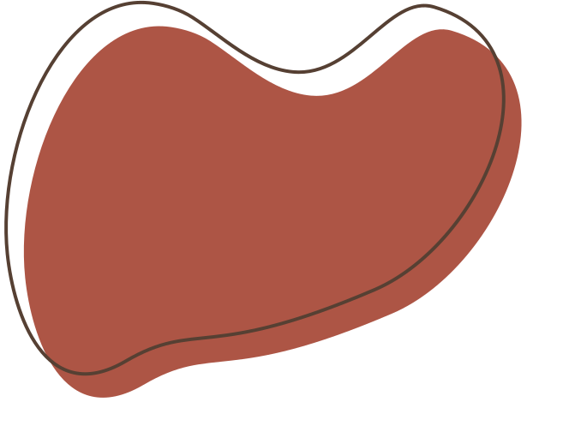
OBSERVER PATTERN

Slide 2
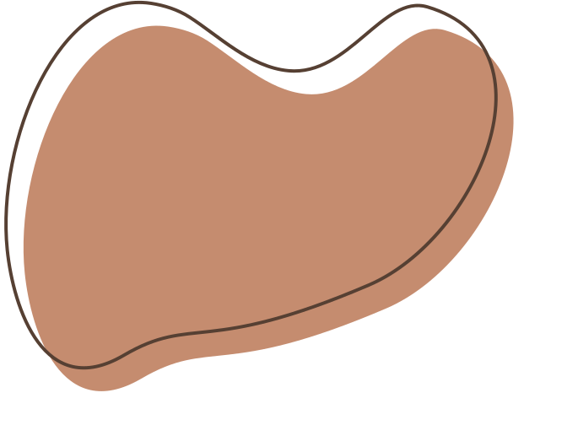







Topic
Topic 1: Importance
Topic 2: Definition
Topic 3: How to use

Slide 3
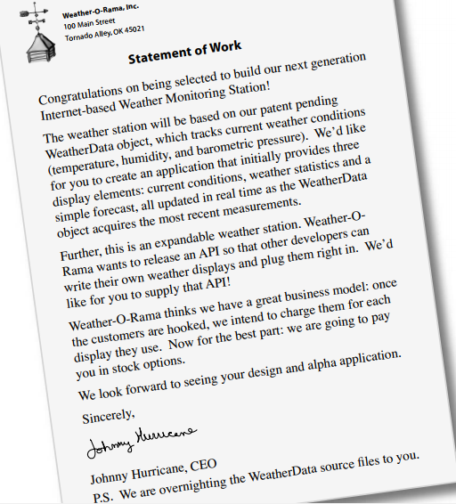

Importance
It was stated with a contract

Slide 4
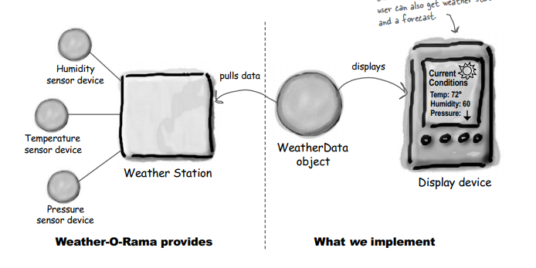
Weather Monitoring application overview

Slide 5
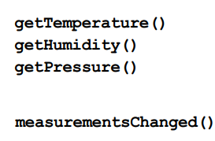

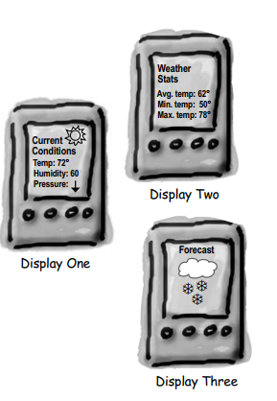
What do we know so far?

Slide 6
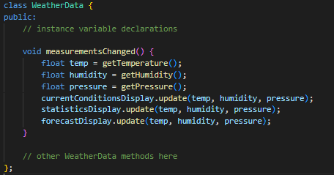

Taking a first, misguided SWAG at the Weather Station

Slide 7
But something went wrong with the implementation

Slide 8
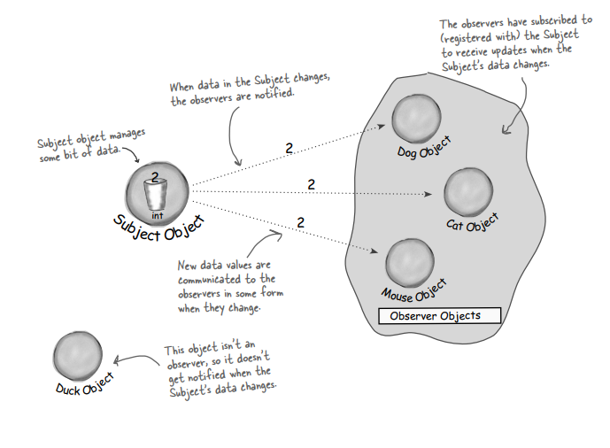
Let Meet the Observer Pattern

Slide 9
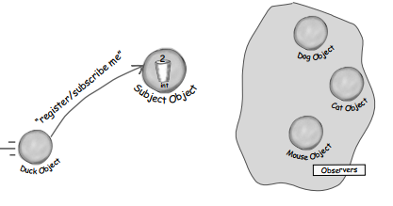
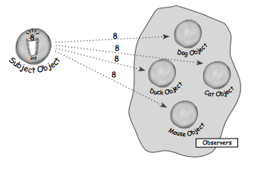
A day in the life of the Observer Pattern

Slide 10
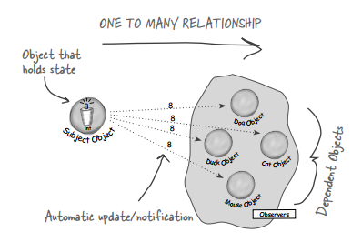
2. Definition
The Observer Pattern defines a one-to-many
dependency between objects so that when one
object changes state, all of its dependents are
notified and updated automatically

Slide 11
The power of Loose Coupling
When two objects are loosely coupled, they can interact, but have very little knowledge of each other.
The Observer Pattern provides an object design where subjects and observers are loosely coupled.

Slide 12
Why ?
The only thing the subject knows about an observer is that it implements a certain interface
We can add new observers at any time
We never need to modify the subject to add new types of observers
We can reuse subjects or observers independently of each other
Changes to either the subject or an observer will not affect the other

Slide 13

3. How to use

Slide 14


Let implement the code

Slide 15
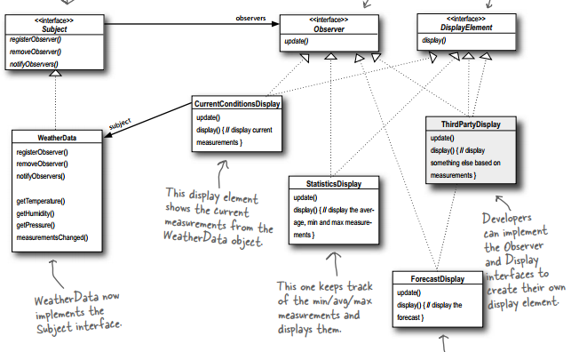
Summary
Advantages
Loose coupling
Reusability
Flexibility
Disadvantage
Complexity
Unintended updates
Memory management

Slide 16

Thanks for listening

